Slide 1
I/O Management &
Disk Scheduling
Lecturer: Li Yang
Contact: liyang23@swjtu.edu.cn
Office: X31506
Faculty: Computer and AI

Slide 2
Outline
I/O Devices
Organization of the I/O function
Operating System Design Issues
I/O Buffering
Disk Scheduling
RAID
Disk Cache

Slide 3
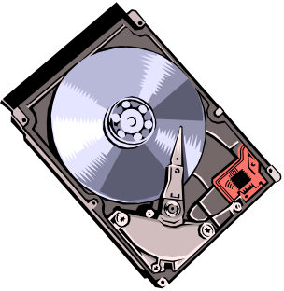
11.1 Categories of I/O Devices
External devices that engage in I/O with computer systems can be grouped into three categories:
  Human readable
    suitable for communicating with the computer user
    printers, terminals, video display, keyboard, mouse
  Machine readable
    suitable for communicating with electronic equipment
    disk drives, USB keys, sensors, controllers
  Communication
    suitable for communicating with remote devices
    Modems（调制解调器）, digital line drivers

Slide 4
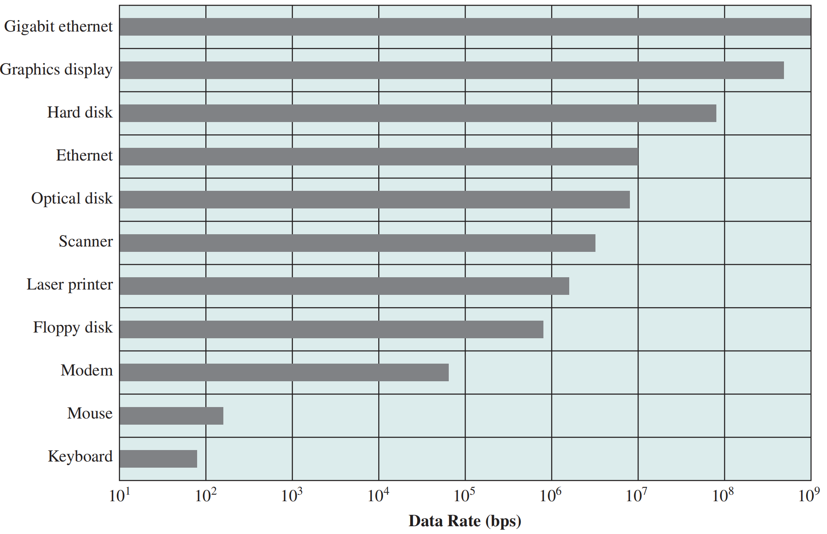
Differences in I/O Devices
Data rate
Application
Complexity of control
Unit of transfer
Data representation
Error conditions

Slide 5
11.2 Organization of the I/O Function
Three Techniques for Performing I/O:
  Programmed I/O
    processor issues an I/O command on behalf of a process to an I/O module;
    that process then busy waits for the operation to be completed before proceeding
  Interrupt-driven I/O
    processor issues an I/O command on behalf of a process
    non-blocking VS blocking
  Direct Memory Access (DMA)
    a DMA module controls the exchange of data between main memory and an I/O module

Slide 6
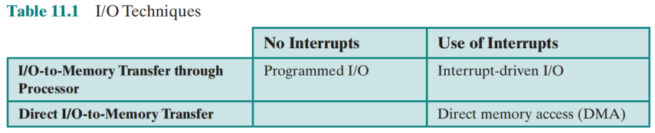
11.2 Techniques for Performing I/O

Slide 7

Evolution of the I/O Function
Processor directly controls a peripheral（外围） device
A controller or I/O module is added. The processor uses programmed I/O without interrupts.
Same configuration as step 2, but now interrupts are employed
The I/O module is given direct control of memory via DMA
The I/O module is enhanced to become a separate processor, with a specialized instruction set tailored for I/O
The I/O module has a local memory of its own and is, in fact, a computer in its own right
Processor do not participate in control
Processor only send command

Slide 8
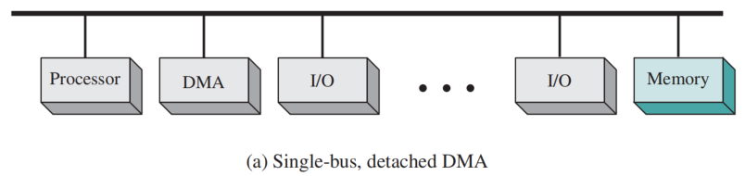
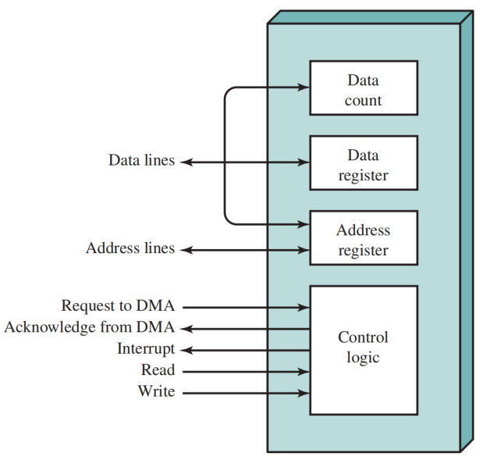
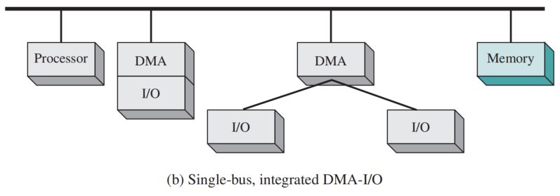
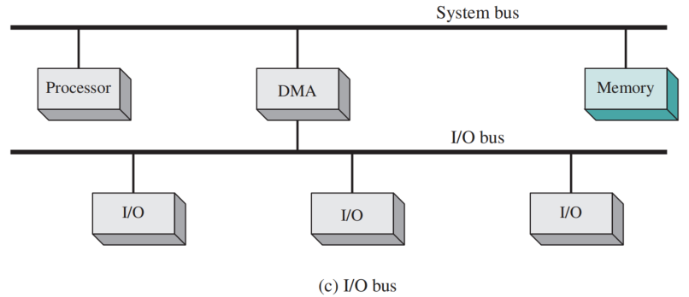
Alternative DMA Configurations
Typical DMA Block Diagram

Slide 9
11.3. Design Objectives of Operating System
Efficiency
  Major effort in I/O design
  Important because I/O operations often form a bottleneck
  Most I/O devices are extremely slow compared with main memory and the processor
  The area that has received the most attention is disk I/O
Generality
  Desirable to handle all devices in a uniform manner
    the way processor view I/O devices
    the way the operating system manages I/O devices and operations
  Diversity of devices makes it difficult to achieve true generality
  Use a hierarchical, modular approach to the design of the I/O function

Slide 10
Logical Structure of the I/O Function
The details of the organization will depend on the type of device and the application
  Logical I/O
    is concerned with managing general I/O functions on behalf of user processes, dealing with the device identifier and simple commands such as open, close, read, and write.

Slide 11
Logical Structure of the I/O Function
The details of the organization will depend on the type of device and the application
  Device I/O:
    The requested operations and data are converted into I/O instructions, channel commands, and controller orders.
    Buffering techniques may be used to improve utilization.

Slide 12
Logical Structure of the I/O Function
The details of the organization will depend on the type of device and the application
  Scheduling and control:
    The actual queueing and scheduling of I/O operations, as well as the control of the operations.
    Thus, interrupts are handled at this layer and I/O status is collected and reported.

Slide 13
11.4. I/O Buffer
Case Discussion
Busy waiting
A process request to read blocks of data from Disk into a data area [X] (virtual addr.)
Suspension on an interrupt
Virtual locations [x] must remain in main memory during the course of the block transfer.
  Otherwise, some data will be lost.
  It is impossible to swap the process out completely.
There is a risk of single-process deadlock.
  The process is swapped out before the I/O operation starting
  Process is suspend by I/O command → I/O is blocked by swapping out → deadlock

Slide 14
Buffering
Buffer：Perform input transfers in advance of requests being made (read-ahead) and perform output transfers some time after the request is made (write-back) .
Block-oriented device
  stores information in blocks that are usually of fixed size
  transfers are made one block at a time
  possible to reference data by its block number
  Storage devices: disks and USB keys are examples
Stream-oriented device
  transfers data in and out as a stream of bytes
  Non-secondary storage devices：terminals, printers, communications ports, and most other devices are examples

Slide 15
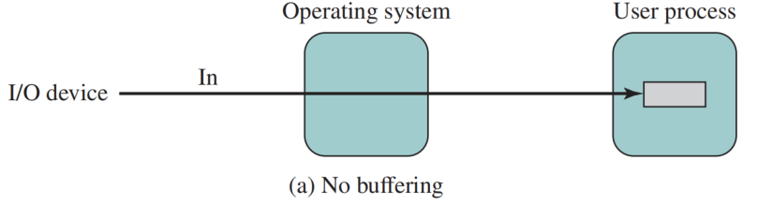
No Buffering
No Buffer
  Without a buffer, the OS directly accesses the device when it needs
  Disadvantage: block/swap

Slide 16
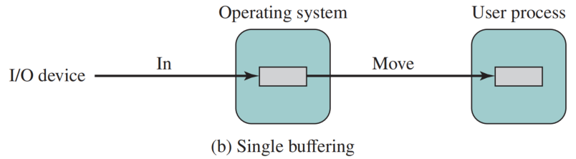

Single Buffer
Operating system assigns a buffer in main memory for an I/O request.
Producer/customer
Max{request interval, data transfer from I/O to buffer} + time from buffer to user space

Slide 17
Block-Oriented Single Buffer
Input transfers are made to the system buffer，called reading ahead/anticipated input (预输入)
Generally provides a speedup compared to the lack of system buffering.
Able to swap the process out because the input operation is taking place in system memory rather than user process memory.
Disadvantages:
  complicates the logic of operating system in terms of the assignment of buffer
  swapping logic is also affected

Slide 18
Stream-Oriented Single Buffer
Line-at-a-time operation
  appropriate for scroll-mode （滚动模式） terminals (dumb terminals)
  input is one line at a time with a carriage return （回车） signaling the end of a line
  output to the terminal is similarly one line at a time
Byte-at-a-time operation
  used on forms-mode （表格模式） terminals
  when each keystroke is significant
  other peripherals such as sensors and controllers
In the case of line-at-a-time I/O, the buffer can be used to hold a single line. The user process is suspended during input, awaiting the arrival of the entire line.
In the case of byte-at-a-time I/O, the interaction between the OS and the user process follows the producer/consumer model.

Slide 19
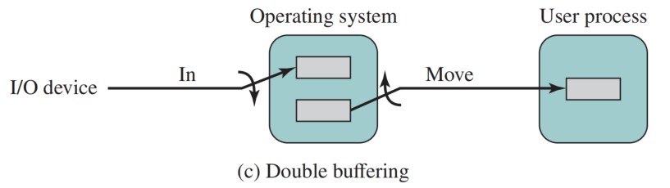
Double Buffer
Use two system buffers instead of one
A process can transfer data to or from one buffer while the operating system empties or fills the other buffer
Also known as buffer swapping （缓冲交换）

Slide 20
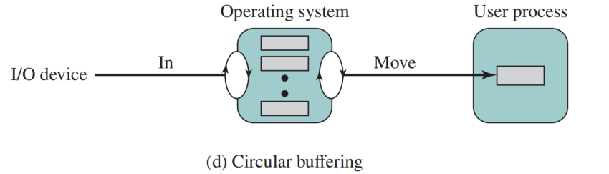
Circular Buffer
Two or more buffers are used
Each individual buffer is one unit in a circular buffer.
This is simply the bounded-buffer producer/consumer model
Used when I/O operation must keep up with process

Slide 21
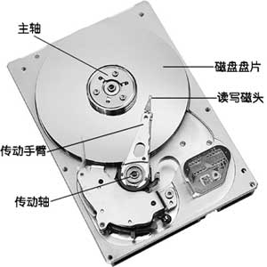
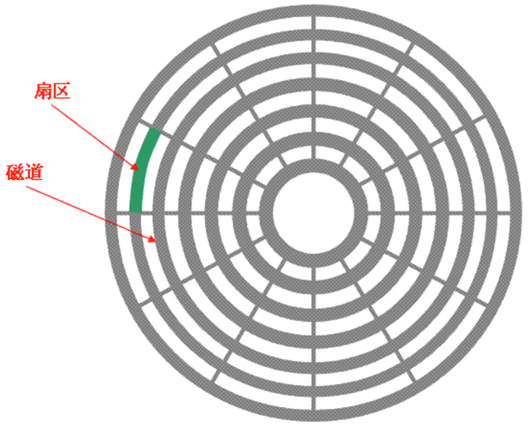
11.5. Disk Scheduling
Physical Structure of HDD (Hard Disk Drive)
Notes:
读写速度快：采用闪存作为存储介质，读取速度相对机械硬盘更快。固态硬盘不用磁头，寻道时间几乎为0。最常见的7200转机械硬盘的寻道时间一般为12-14毫秒，而固态硬盘可以轻易达到0.1毫秒甚至更低。
防震抗摔性：
低功耗：固态硬盘的功耗上要低于传统硬盘。
无噪音：固态硬盘没有机械马达和风扇，工作时噪音值为0分贝。基于闪存的固态硬盘在工作状态下能耗和发热量较低（但高端或大容量产品能耗会较高）。内部不存在任何机械活动部件，不会发生机械故障，也不怕碰撞、冲击、振动。由于固态硬盘采用无机械部件的闪存芯片，所以具有了发热量小、散热快等特点。 [5]
工作温度范围大：
轻便：
缺点: 容量, 寿命限制, 售价高：市场上的128GB 固态硬盘产品的价格大约在在550元人民币左右，128GB SLC（单层单元）固态硬盘价格则高达2000元以上。 [1]

Slide 22
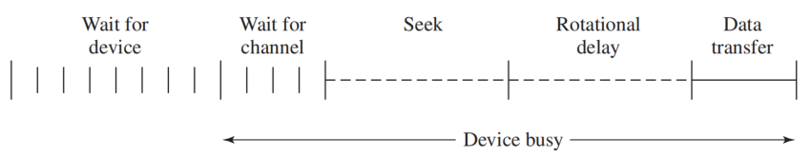
Disk Performance Parameters
The actual details of disk I/O operation depend on the:
  computer system
  operating system
  nature of the I/O channel and disk controller hardware
Timing of a Disk I/O Transfer

Slide 23
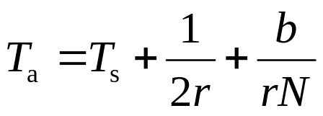
Positioning the Read/Write Heads
When the disk drive is operating, the disk is rotating at constant speed
To read or write the head must be positioned at the desired track and at the beginning of the desired sector on that track
Track selection involves moving the head in a movable-head system
  The time it takes to position the head at the track is known as seek time
  The time it takes for the beginning of the sector to reach the head is known as rotational delay
The sum of the seek time and the rotational delay equals the average access time (存取时间)

Slide 24
Case Discussion
Consider a disk with an advertised average seek time of 4 ms, rotation speed of 7,500 rpm, and 512-byte sectors with 500 sectors per track. Suppose we wish to read a file consisting of 2,500 sectors for a total of 1.28 Mbytes.
We would like to estimate the total time for the transfer.

Slide 25
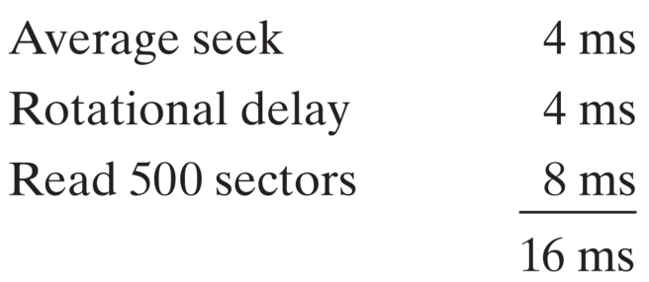
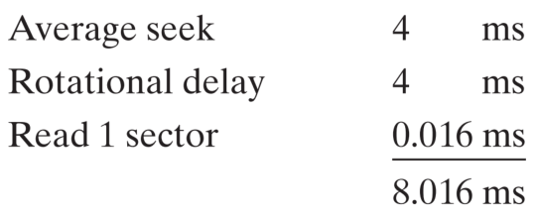
Total time for the transfer
the file is stored as compactly as possible on the disk， sequential organization
read the same data using random access rather than sequential access
The order in which sectors are read from the disk has a tremendous effect on I/O performance！

Slide 26
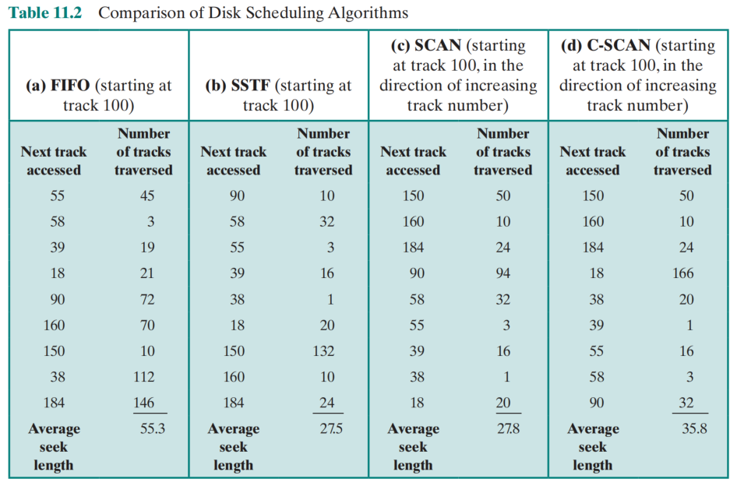
Disk Scheduling Policies
To improve matters, we need to reduce the average time spent on seeks via disk scheduling policies.
Case: 55, 58, 39, 18, 90, 160, 150, 38, 184
First-In-First-Out
Priority
Last-In-First-Out
Shortest-Service-Time-First
SCAN
C-SCAN
N-STEP-SCAN
FSCAN

Slide 27
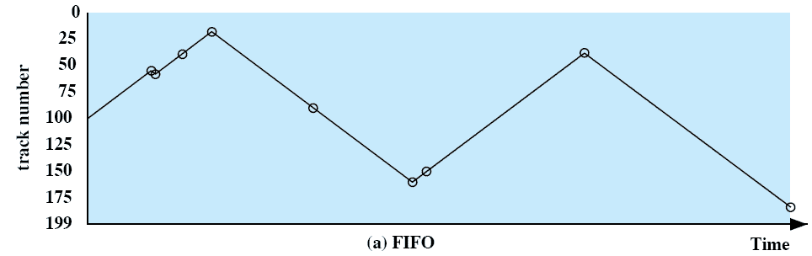
First-In, First-Out (FIFO)
Processes in sequential order
Fair to all processes
Approximates random scheduling in performance if there are many processes competing for the disk
Case: 55, 58, 39, 18, 90, 160, 150, 38, 184

Slide 28
Priority (PRI)
Control of the scheduling is outside the control of disk management software
Goal is not to optimize disk utilization but to meet other objectives
Short batch jobs and interactive jobs are given higher priority
Provides good interactive response time
Longer jobs may have to wait an excessively long time

Slide 29
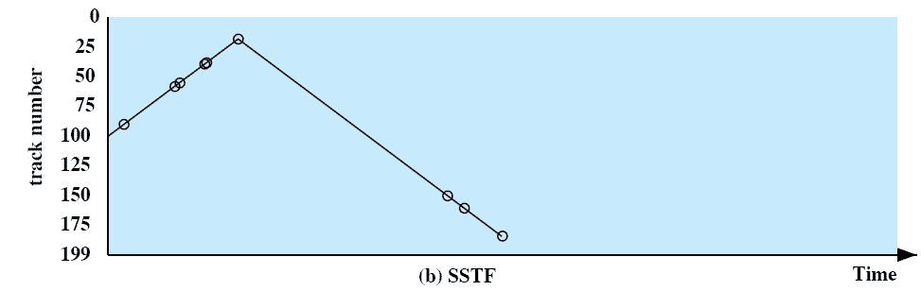
Shortest Service Time First (SSTF)
Select the disk I/O request that requires the least movement of the disk arm from its current position
Always choose the minimum seek time
starvation
Case: 55, 58, 39, 18, 90, 160, 150, 38, 184

Slide 30
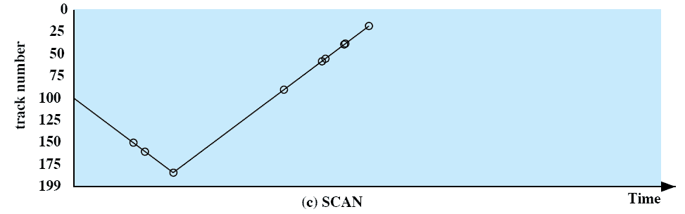
SCAN
Also known as the elevator algorithm
Arm moves in one direction only
  satisfies all requests until it reaches the last track in that direction then the direction is reversed
Favors jobs whose requests are for tracks nearest to both innermost and outermost tracks
Case: 55, 58, 39, 18, 90, 160, 150, 38, 184

Slide 31
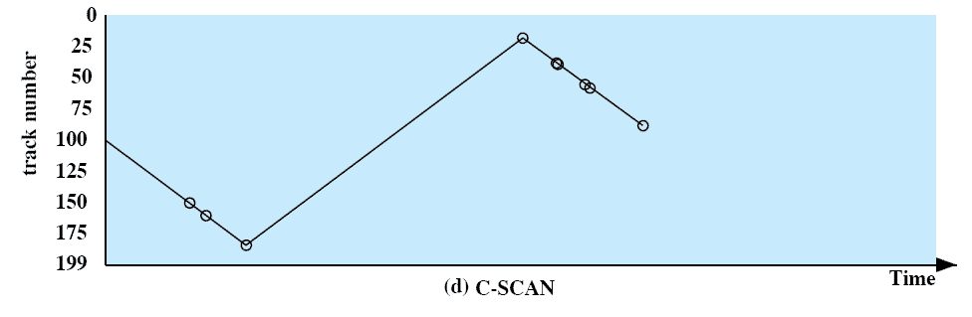
C-SCAN (Circular SCAN)
Restricts scanning to one direction only
When the last track has been visited in one direction, the arm is returned to the opposite end of the disk and the scan begins again
Case: 55, 58, 39, 18, 90, 160, 150, 38, 184

Slide 32
N-Step-SCAN & FSCAN
Issues: With SSTF, SCAN, and C-SCAN, it is possible the arm may not move for a considerable period of time——N-step-SCAN and FSCAN
N-step-SCAN
  Segments the disk request queue into subqueues of length N
  While a queue is being processed new requests must be added to some other queue
FSCAN:
  Uses two subqueues
  When a scan begins, all of the requests are in one of the queues
  During scan, all new requests are put into the other queue

Slide 33
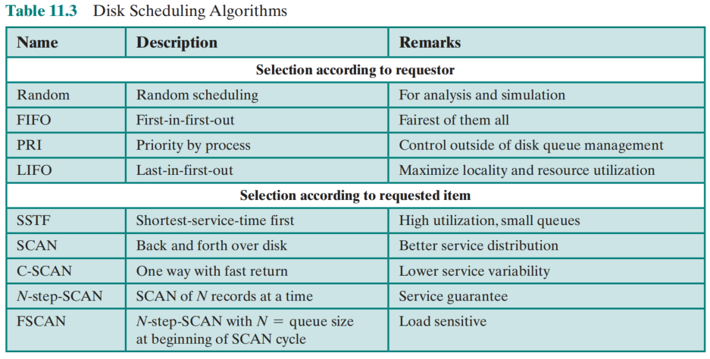
Disk Scheduling Algorithms
Table 11.3 Disk Scheduling Algorithms

Slide 34
11.6. Disk Cache
Reduces average memory access time by exploiting the principle of locality
Disk cache is a buffer in main memory for disk sectors
  Contains a copy of some of the sectors on the disk
when an I/O request is made for a particular sector, a check is made to determine if the sector is in the disk cache
  if YES
    the request is satisfied via the cache
  if NO
    the requested sector is read into the disk cache from the disk

Slide 35
Design Considerations
When an I/O request is satisfied from the disk cache, the data in the disk cache must be delivered to the requesting process.
  transferring the block of data within main memory from the disk cache to memory assigned to the user process
  simply by using a shared memory capability and passing a pointer to the appropriate slot in the disk cache.
    saves the time of a memory-to-memory transfer and also allows shared access by other processes using the readers/writers model.
    A second design issue has to do with the replacement strategy
  least recently used (LRU)（ most commonly used ）
  least frequently used (LFU)

Slide 36
Least Frequently Used (LFU)
The block that has experienced the fewest references (使用次数最少) is replaced
A counter is associated with each block
Counter is incremented each time block is accessed
When replacement is required, the block with the smallest count is selected
Issues
  certain blocks are referenced relatively infrequently overall
  when they are referenced, there are short intervals of repeated references due to locality, thus building up high reference counts.
  After such an interval is over, the reference count may be misleading and not reflect the probability that the block will soon be referenced again.

Slide 37
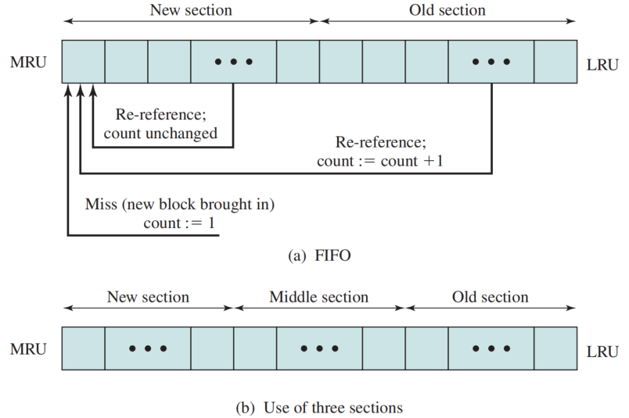
Frequency-Based Replacement
Idea :
  The referenced block is moved to the top of the stack.
  If the block was already in the new section, its reference count is not incremented; otherwise, it is incremented by 1.
  Given a sufficiently large new section, the reference are repeatedly re-referenced within a short interval remaining unchanged.
  On a miss, the block with the smallest reference will be replaced.
  Issue:
    relatively frequently referenced blocks are replaced.
Frequency-Based Replacement
Frequency-Based Replacement

Slide 38
7. RAID(独立磁盘冗余阵列)
Redundant Array of Independent Disks
The development of arrays of disks that operate independently and in parallel.
  With multiple disks, separate I/O requests can be handled in parallel, as long as the data required reside on separate disks.
  a single I/O request can be executed in parallel if the block of data to be accessed is distributed across multiple disks.

Slide 39
RAID(独立磁盘冗余阵列)
Consists of seven levels, zero through six
Design architectures share three characteristics:
  RAID is a set of physical disk drives viewed by the operating system as a single logical drive
  data are distributed across the physical drives of an array in a scheme known as striping(条带)
  redundant disk capacity is used to store parity information （校验）, which guarantees data recoverability in case of a disk failure

Slide 40
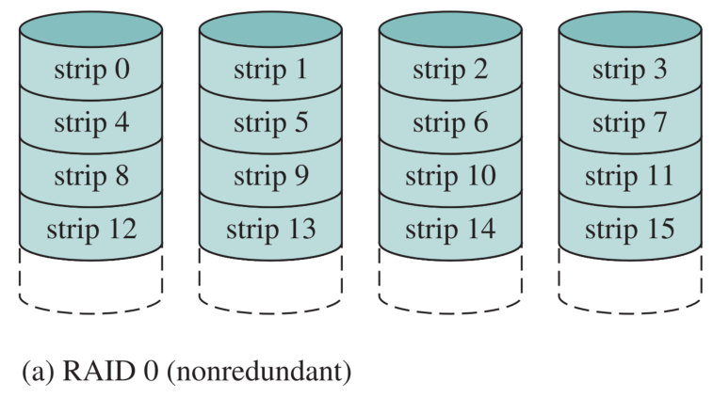
RAID Level 0
Not a true RAID because it does not include redundancy to improve performance or provide data protection
User and system data are distributed across all of the disks in the array
Logical disk is divided into strips
N

Slide 41
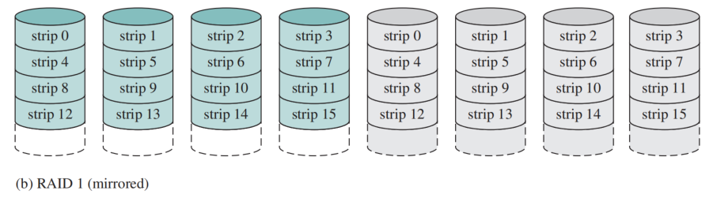
RAID Level 1
Redundancy is achieved by the simple expedient of duplicating all the data
When a drive fails the data may still be accessed from the second drive
Principal disadvantage is the cost
2N

Slide 42
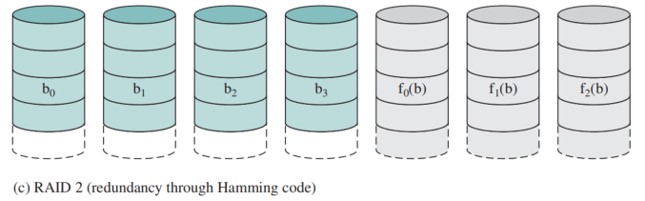

RAID Level 2
Each disk head is in the same position， employs parallel access
all member disks participate in the execution of every I/O request
An error-correcting code is calculated across corresponding bits on each data disk, and the bits of the code are stored in the corresponding bit positions on multiple parity disks（奇偶校验）.
Typically a Hamming code is used
$$N+M$$
M parity disks

Slide 43
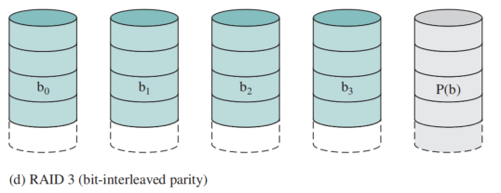
RAID Level 3
Requires only a single redundant disk, no matter how large the disk array
Employs parallel access, with data distributed in small strips
Can achieve very high data transfer rates
N+1

Slide 44
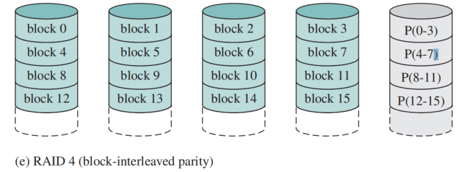
RAID Level 4
Makes use of an independent access technique
A bit-by-bit parity strip is calculated across corresponding strips on each data disk, and the parity bits are stored in the corresponding strip on the parity disk
Involves a write penalty when an I/O write request of small size is performed
N+1

Slide 45
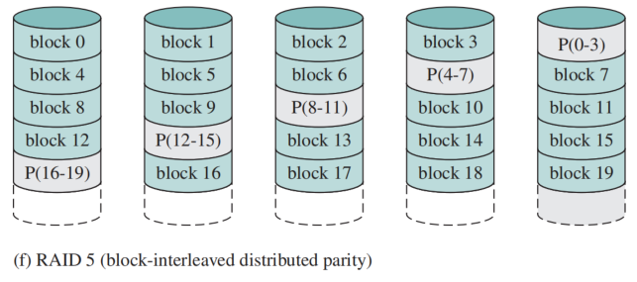
RAID Level 5
Similar to RAID-4 but distributes the parity bits across all disks
Typical allocation is a round-robin scheme
Has the characteristic that the loss of any one disk does not result in data loss
N+1

Slide 46
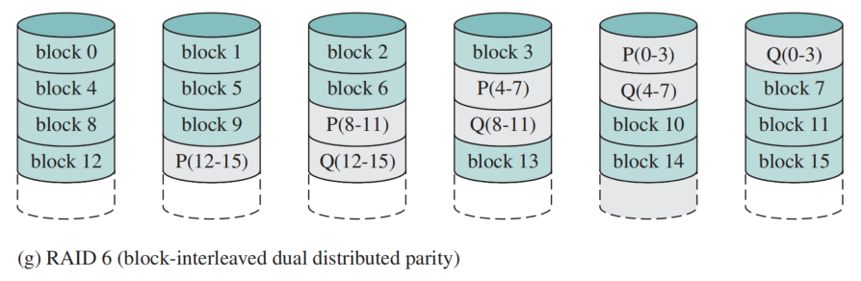
RAID Level 6
Two different parity calculations are carried out and stored in separate blocks on different disks
Provides extremely high data availability
Incurs a substantial write penalty because each write affects two parity blocks
N+2

Slide 47
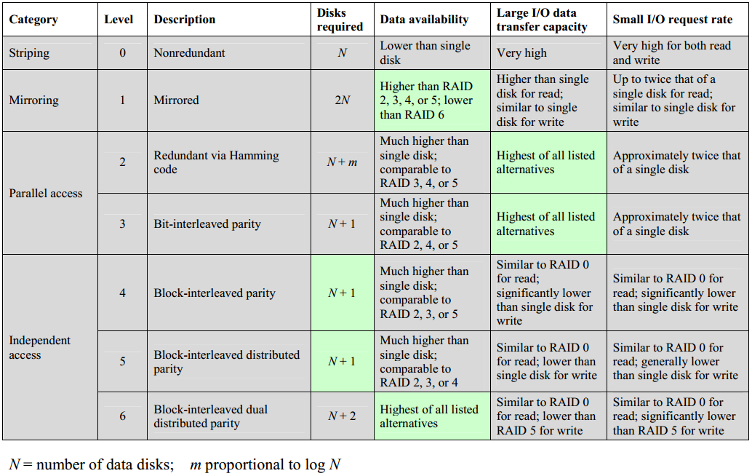
RAID Levels

Slide 48
Quiz
Consider a 4-drive, 200GB-per-drive RAID array. What is the available data storage capacity for each of the RAID levels, 0, 1, 3, 4, 5, and 6?

Slide 49
Summary
I/O architecture is the computer system’s interface to the outside world
  I/O functions are generally broken up into a number of layers
  A key aspect of I/O is the use of buffers that are controlled by I/O utilities
Buffering smoothens out the differences between the speeds
  The use of buffers also decouples the actual I/O transfer from the address space of the application process
Disk I/O has the greatest impact on overall system performance
  Two of the most widely used approaches are disk scheduling and the disk cache
A disk cache is a buffer, usually kept in main memory, that functions as a cache of disk block between disk memory and the rest of main memory

Slide 50

单选题
1分
此题未设置答案，请点击右侧设置按钮
1.在操作系统中,用户在使用I/O设备时,通常采用( )。
A
物理设备名
B
逻辑设备名
C
虚拟设备名
D
设备牌号
提交
Notes:
B

Slide 51
单选题
1分
1.在操作系统中,用户在使用I/O设备时,通常采用( )。
A
物理设备名
B
逻辑设备名
C
虚拟设备名
D
设备牌号
提交
Notes:
B

Slide 52
单选题
1分
此题未设置答案，请点击右侧设置按钮
2.操作系统采用缓冲技术,能够减少对CPU的( )次数,从而提高资源的利用率。
A
中断
B
访问
C
控制
D
依赖
提交
Notes:
A

Slide 53
单选题
1分
2.操作系统采用缓冲技术,能够减少对CPU的( )次数,从而提高资源的利用率。
A
中断
B
访问
C
控制
D
依赖
提交
Notes:
A

Slide 54
单选题
1分
此题未设置答案，请点击右侧设置按钮
3.CPU输出数据的速度远远高于打印机的打印速度,为了解决这一矛盾,可采用( )。
A
并行技术
B
通道技术
C
缓冲技术
D
虚存技术
提交
Notes:
C

Slide 55
单选题
1分
3.CPU输出数据的速度远远高于打印机的打印速度, 为了解决这一矛盾,可采用( )。
A
并行技术
B
通道技术
C
缓冲技术
D
虚存技术
提交
Notes:
C

Slide 56
单选题
1分
此题未设置答案，请点击右侧设置按钮
4.缓冲技术用于( )。
A
提高主机和设备交换信息的速度
B
提供主、辅存接口
C
提高设备利用率
D
扩充相对地址空间
提交
Notes:
A

Slide 57
单选题
1分
4.缓冲技术用于( )。
A
提高主机和设备交换信息的速度
B
提供主、辅存接口
C
提高设备利用率
D
扩充相对地址空间
提交
Notes:
A

Slide 58
单选题
1分
此题未设置答案，请点击右侧设置按钮
5.通道是一种( )。
A
I/O端口
B
数据通道
C
I/O专用处理机
D
软件工具
提交
Notes:
C

Slide 59
单选题
1分
5.通道是一种( )。
A
I/O端口
B
数据通道
C
I/O专用处理机
D
软件工具
提交
Notes:
C

